Slide 1
Report Launch: key messages
Jane Davidson, Chair, Wales Net Zero 2035
https://netzero2035.wales

Slide 2
Our mandate
The Co-operation Agreement: 2021
A Greener Wales to Tackle Climate Change and the Nature Emergency
“
Commission independent advice to examine potential pathways to net zero by 2035 – the current target date is 2050. This will look at the impact on society and sectors of our economy and how any adverse effects may be mitigated, including how the costs and benefits are shared fairly.
”

Slide 3
The Well-being of Future Generations (Wales) Act 2015
Globally responsible
Prosperous
Long term
Prevention
Collaboration
Integration
Involvement
Society
Environment
Economy
Culture
Vibrant culture and thriving Welsh language
Resilient
Healthier
Cohesive communities
More equal

Slide 4
Our crosscutting ‘enablers'
Finance
Co-benefits
Engagement & communication
Enablers
Nature
Just Transition
International impacts
Education & skills
Circular economy
Futureproofing
Psychology & behaviour
Governance & legal

Slide 5
Our participation model – linked to the 5 ways of working
6 reference groups: Enablers, Education, Food, Energy, Buildings. Connections
With relevant stakeholders and the public through the work of our reference groups
Participation
&
Engagement
With partner organisations to test and socialise our conclusions
Post publication proposal for deliberative democracy type approach
With the Wales Youth Parliament to test our conclusions with young people in Wales

Slide 6
Our framework
Well-being of Future Generations (Wales) Act 2015
Planetary boundaries
Crosscutting enablers
Participation & Engagement
Net Zero 2035
Challenges

Slide 7
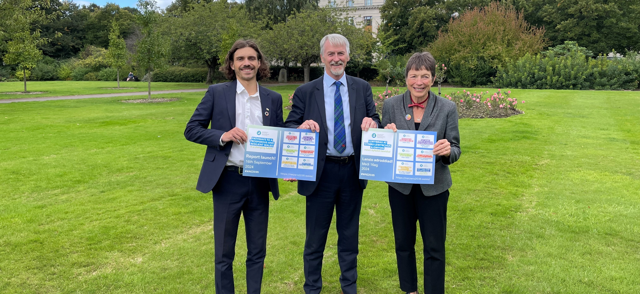
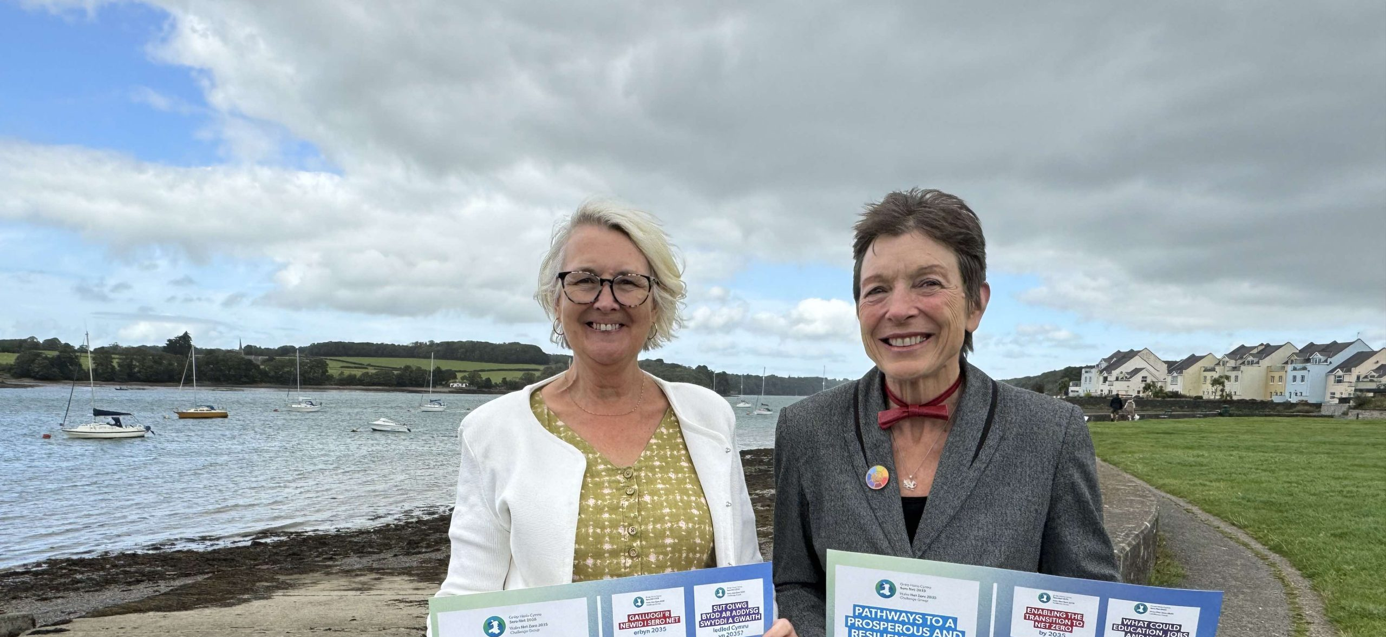
Launch of ‘Pathways to a Prosperous and Resilient Wales’ September 2024
The published documents include 7 reports:
Summary report
Enabling the transition to net zero in Wales by 2035.
What could education, jobs and work, look like across Wales by 2035?
How could Wales feed itself by 2035?
How could Wales meet energy needs by 2035 whilst phasing out fossil fuels?
How could Wales heat and build homes and workplaces by 2035?
How could people and places be connected across Wales by 2035?

Slide 8
WNZ 2035: How our Reports Work
Introduction – to the areas covered and why
Pathway – immediate term 2025-2027/ Near term 2027-2030/Long term 2030-2035
A Our Opportunity
B Summary of pathway advice including references and case studies
Our Approach
C Our Approach

Slide 9
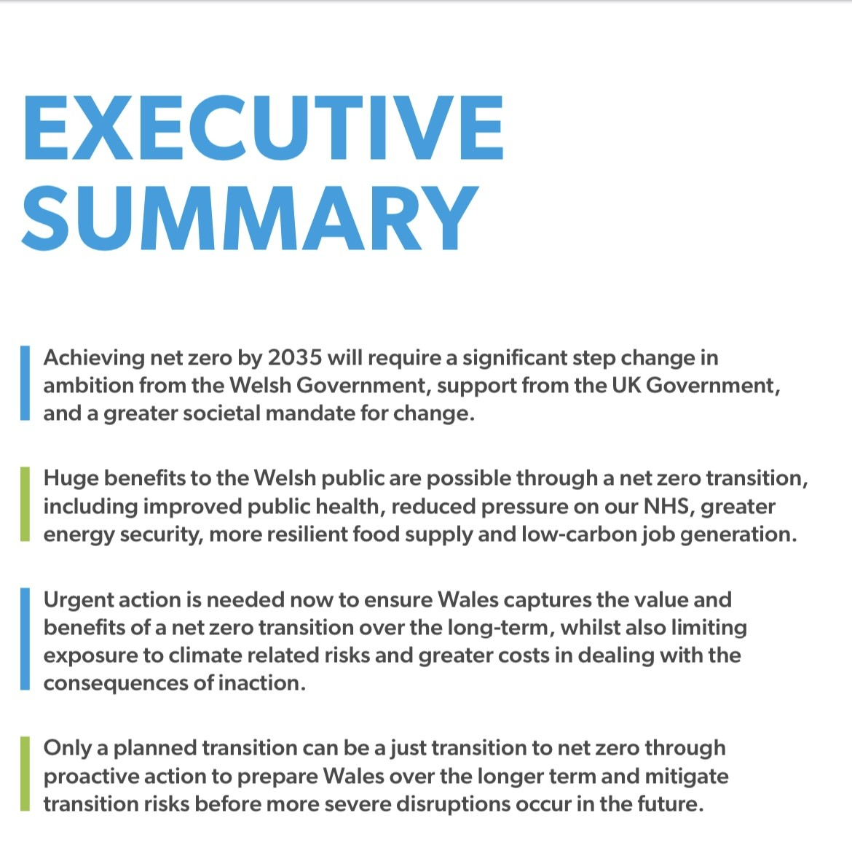
WNZ 2035: 1

Slide 10
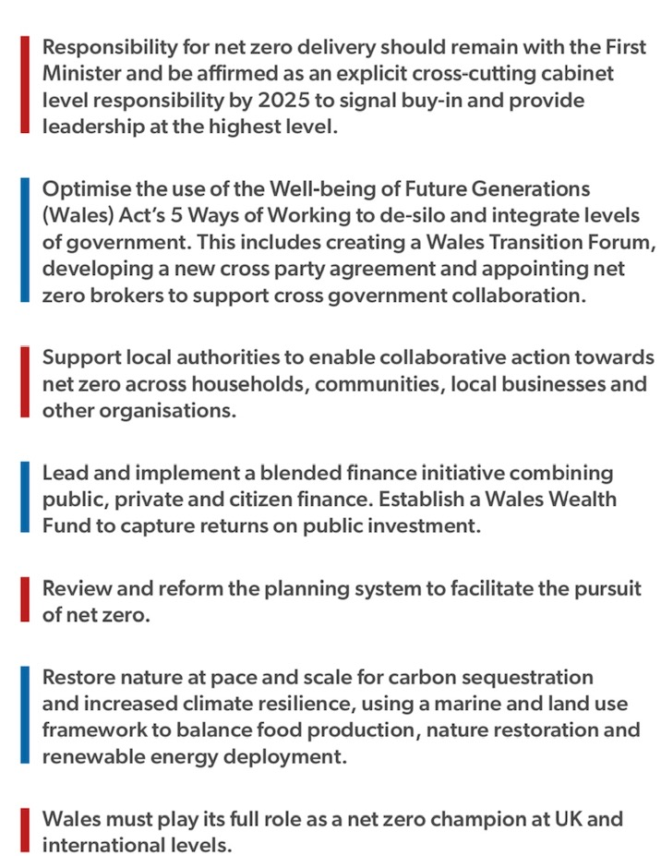
WNZ 2035: 2

Slide 11
WNZ 2035: 3

Slide 12
WNZ 2035: 4 (slide 1)

Slide 13
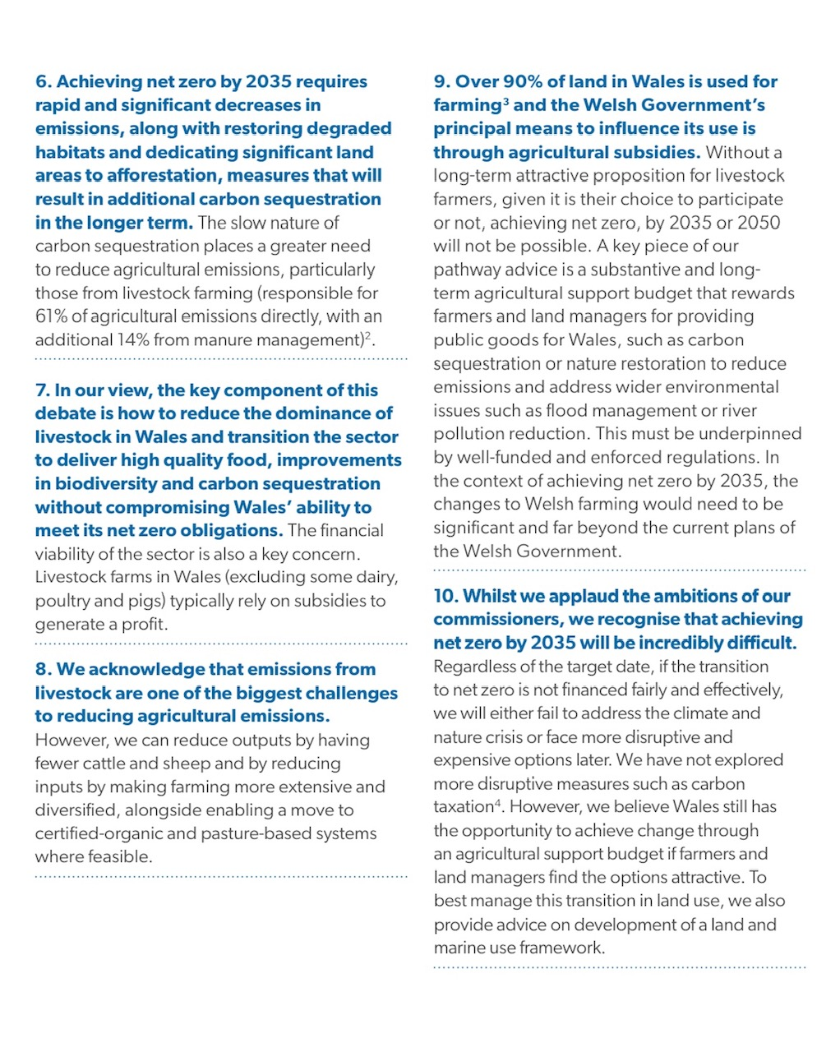
WNZ 2035: 4 (slide 2)

Slide 14
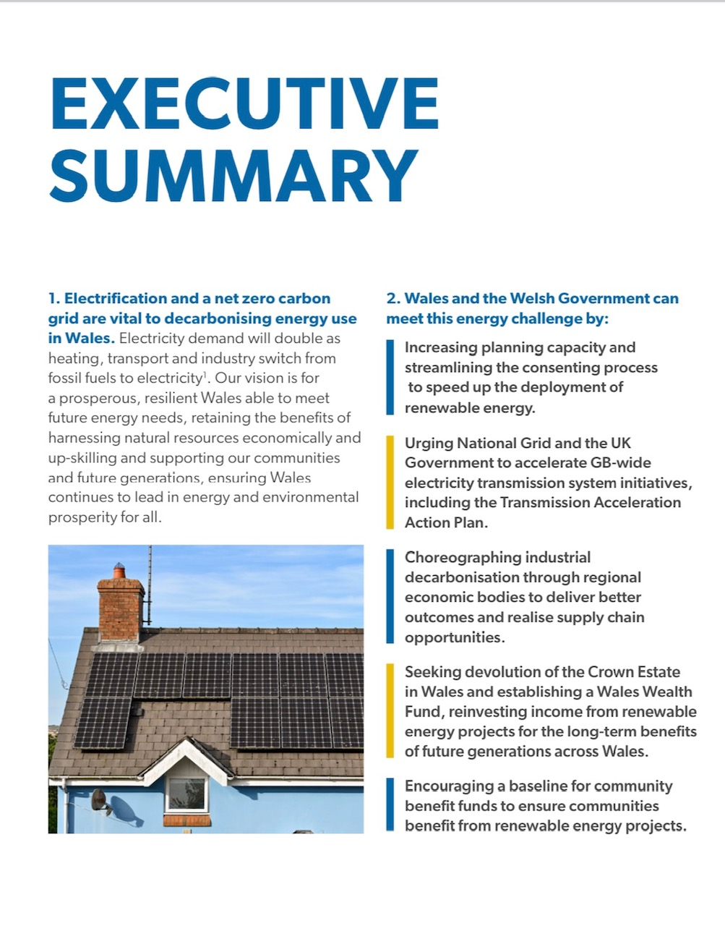
WNZ 2035: 5 (slide 1)

Slide 15
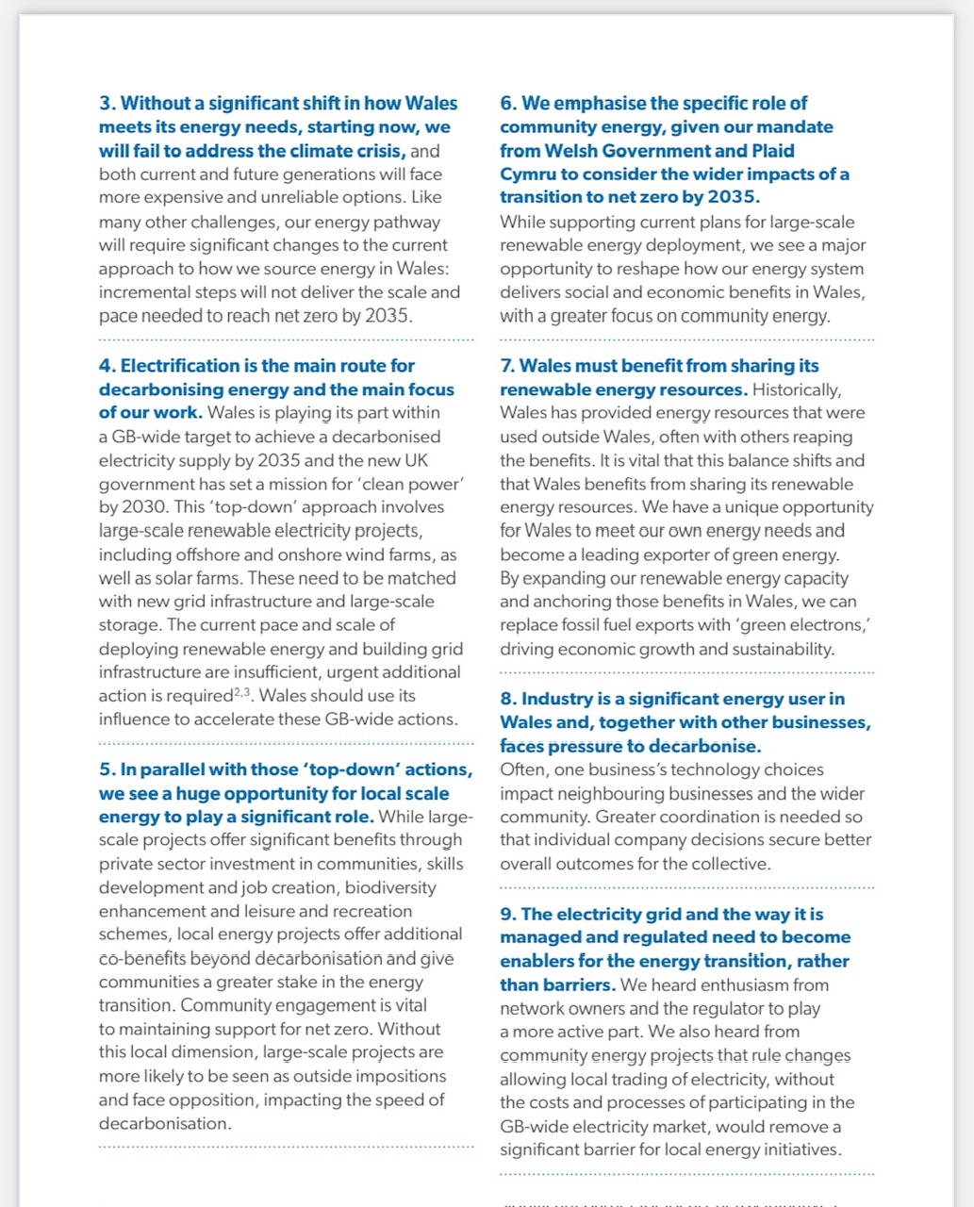
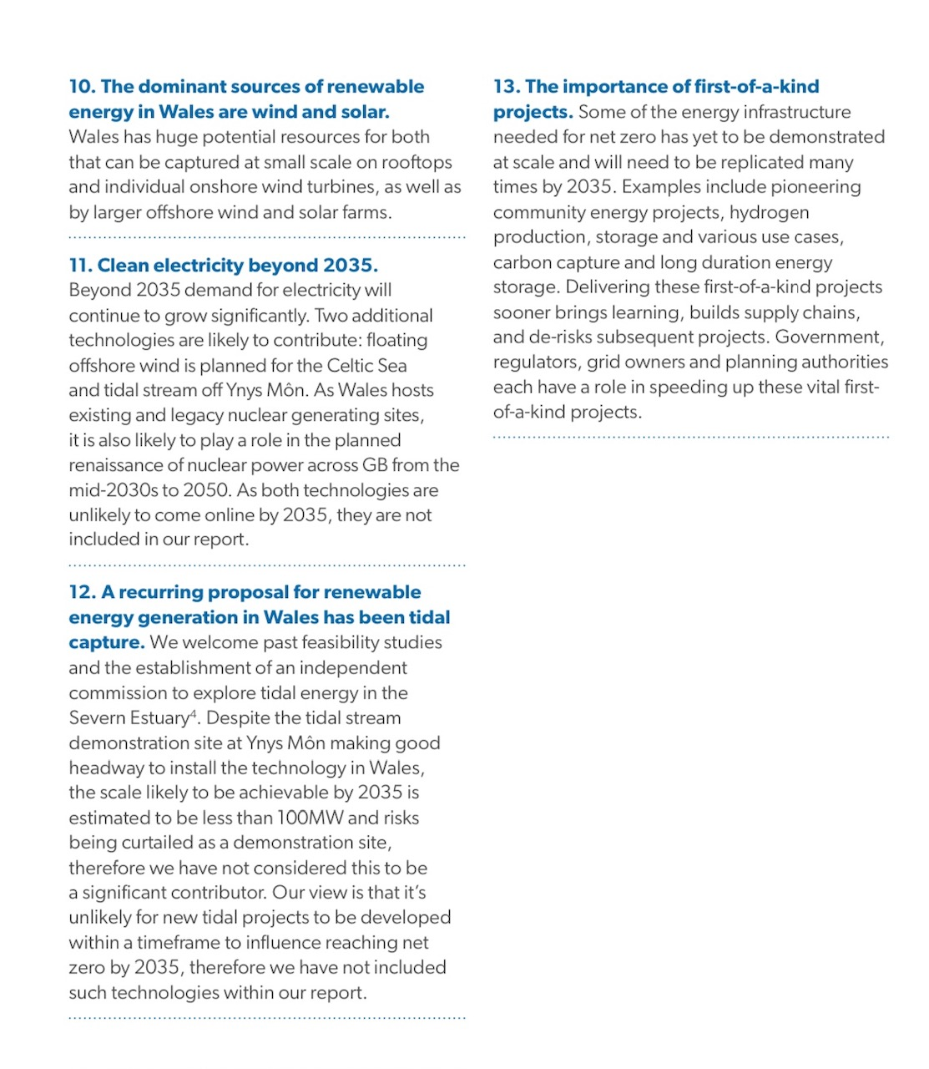
WNZ 2035: 5 (slide 2)

Slide 16
WNZ 2035: 6

Slide 17
WNZ 2035: 7

Slide 18
…other countries/cities/organisations are interested in this approach to deliver on the SDGs and climate ambition by 2030-2035. The United Nations proposed a Special Envoy for Future Generations based on the Wales model at the Summit of the Future. It was agreed by the #UNGA in New York last Sunday
Watch here https://www.youtube.com/watch?v=DfR6xHZ1OBQ
Diolch/thanks
Jane Davidson Chair, Net Zero Wales 2035

